Slide 1

CHURN PREDICTION MODEL
BY SAHIL MAKEN

Slide 2
Agenda
Data Insights
Churn Model
Action Plan & Strategies

Slide 3
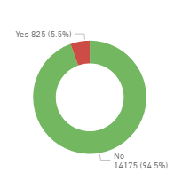
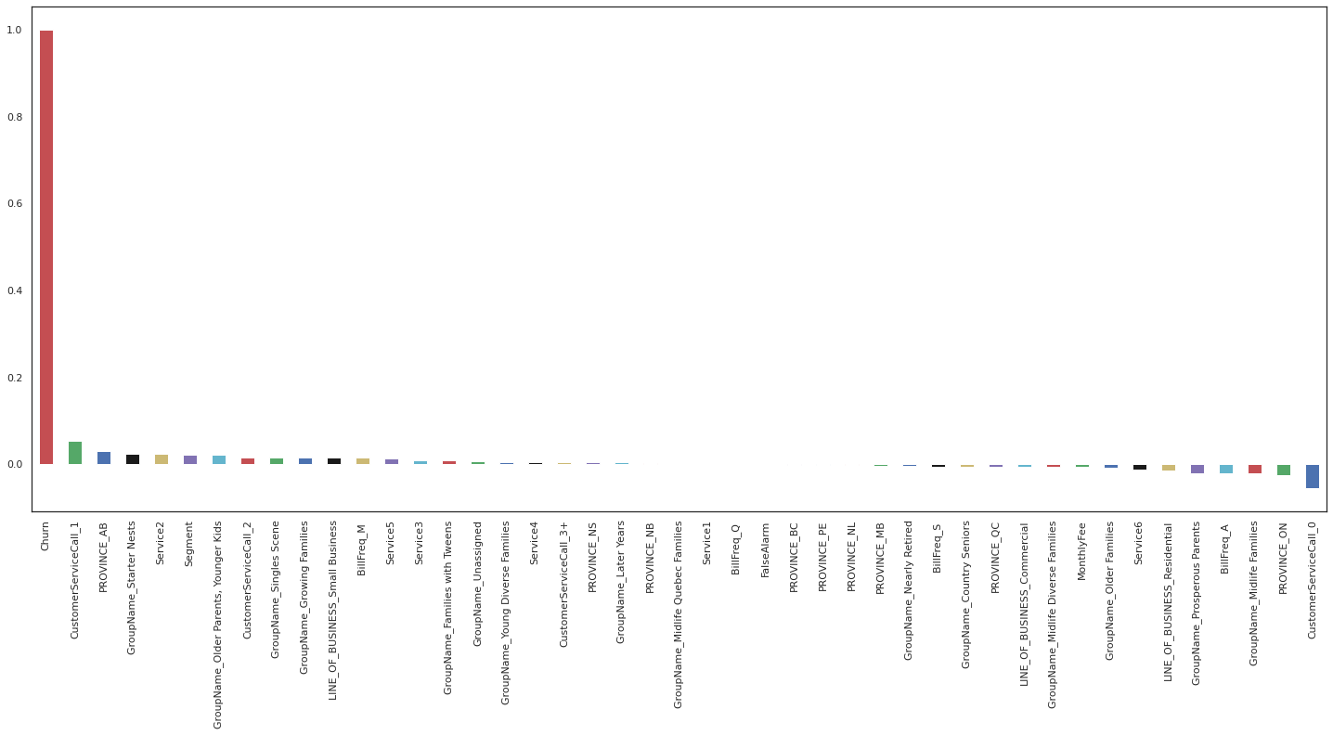
Data Insights
Introduction
Churn is a one of the biggest problems for companies. It is more expensive to acquire a new customer than to keep the existing one from leaving.
The Churn rate for the last 6 months is 5.5%
Exploratory Data Analysis
Correlation matrix is used to determine which features are most responsible for customer Churn
High Impact features
Customer Service Call frequency
Customer Group
Line of Business
Province

Slide 4
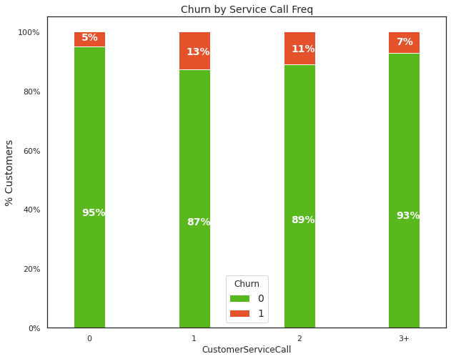
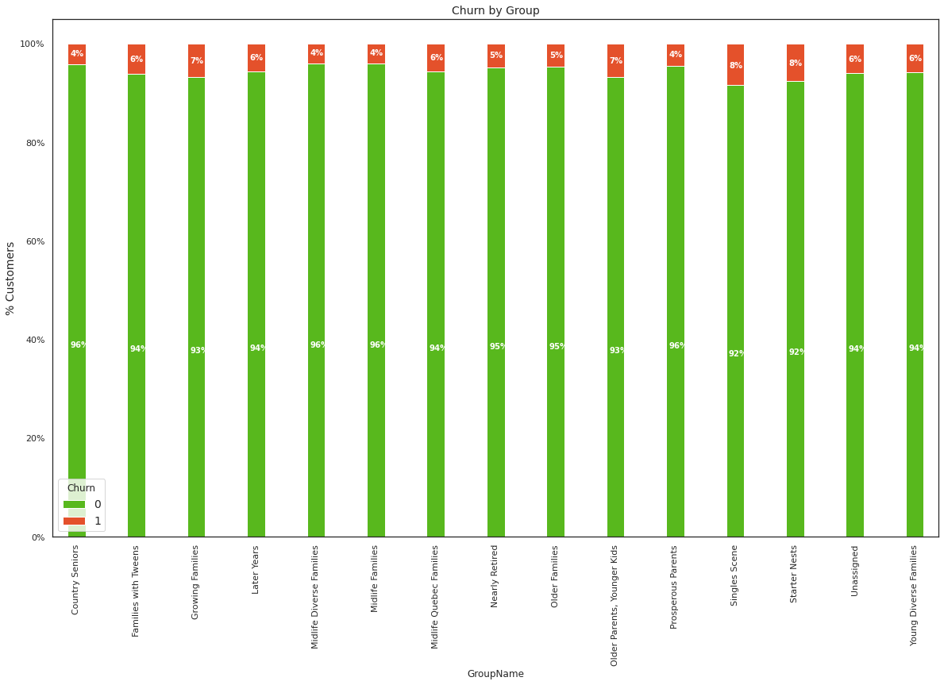
Data Insights
Legend
0| Not Churn
1| Churn
1. Customer Service Call frequency
2. Customer Group
Insight:
High Churn rate among customers with unsatisfied service.
(Call Frequency >=1)
Anomaly: Customers with 3+ call frequency could be categorized as loyal customers
Insight:
High Churn rate among young adult customers
(Group category: Single scenes, starter nests, growing families etc.)

Slide 5
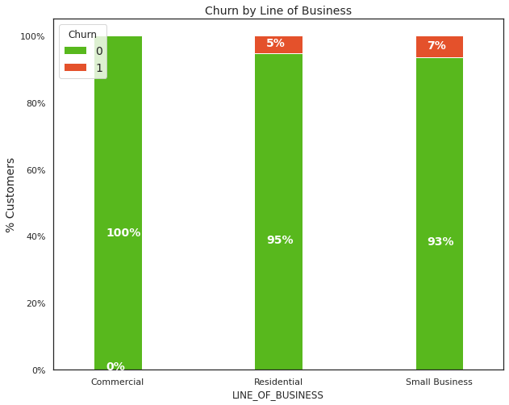
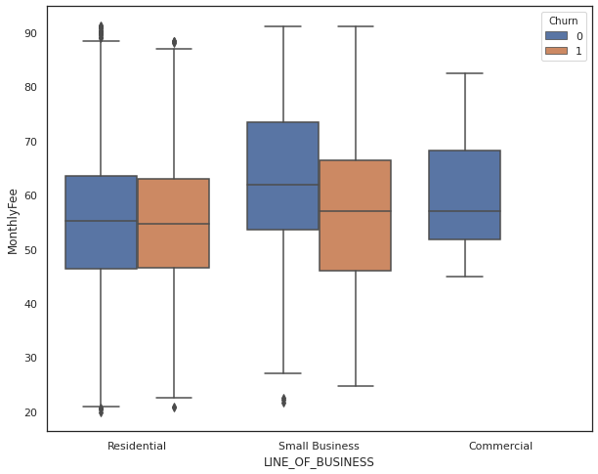
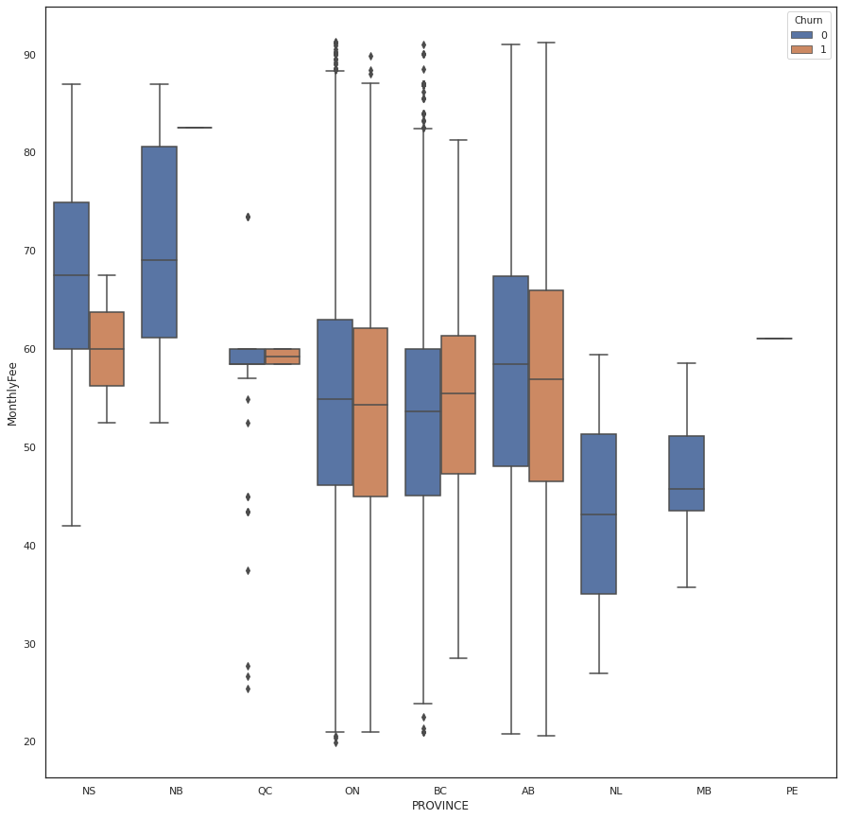
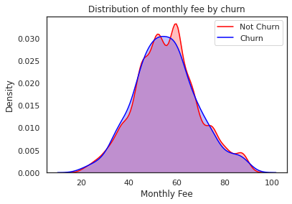
Data Insights
Legend
0| Not Churn
1| Churn
3. Line of Business
4. Province
Insight:
Small Business Owners are more likely to Churn
Monthly Fee does not have an impact on Customer Churn across Business lines.
Insight:
Monthly Fee does not have an impact on Customer Churn across Province.
Monthly Fee distribution plot

Slide 6
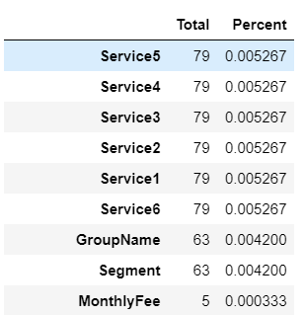
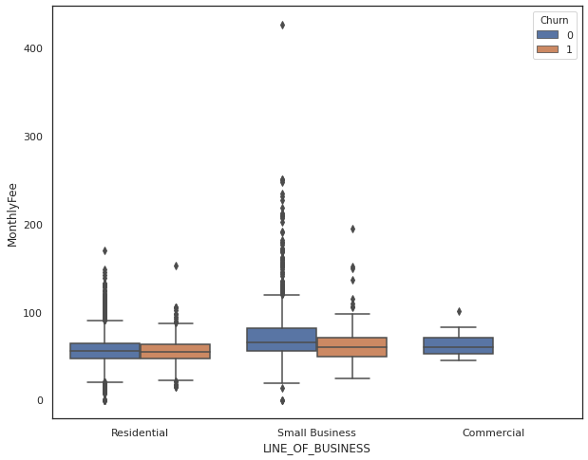
Churn Model Script: GitHub Repo
Legend
Class 0| Not Churn
Class 1| Churn
Test Hypothesis: Young adult financially independent customers with unsatisfied customer service have high probability of Churning.
Objective: Design a Machine Learning Model to validate the test hypothesis and predict Customer Churn behavior.
Model: Supervised Classification
Dataset type: Imbalanced (Class 1: 5.5%, Class 0: 94.5%)
Evaluation Metric: Recall (True Positive Rate) – Focus Class 1 Recall value
Data Pre-Processing:
Training Dataset (Format: Excel = 15,000 records, 17 independent variables, 1 dependent variable)
Step 1: Missing Data – Remove records with missing data (Rule -Missing data <= 5% of total data)
Step 2: Remove Outliers – Remove records outside 1.5 times of Inter-Quartile range
Step 3: Remove features (Dimensionality reduction) – Minimal correlation
drop = ['SK_CUSTOMER','Contact_End','StartDate’]
*Assumption: Contact End date feature is not end of the contract date, based on the following analysis
Records in training dataset with contact end date < start date.
Contact end date feature included in Scoring dataset with dates in the past from current date.

Slide 7
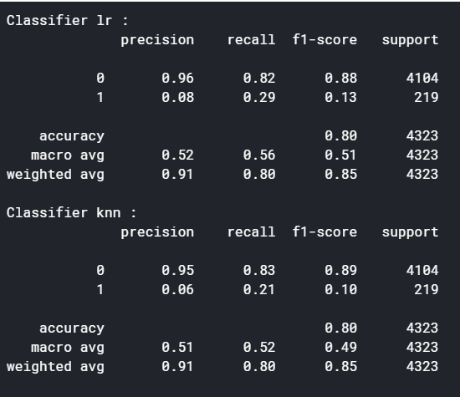
Churn Model Script: GitHub Repo
Legend
Class 0| Not Churn
Class 1| Churn
Data Pre-Processing
Step 4: One-Hot Encoding
– Convert categorical variables to numerical.
Increased # of features
~ 3 times
Step 5: Remove highly correlated independent variables
No independent variables with high correlation (threshold (0.8,-0.8)
Step 6: Data Normalization – MinMaxScaler (0,1) – Scaling the data to standard scale of 0 to 1.
Step 8: Balancing training data-set
Technique – SMOTETomek – Creating synthetic data for Class 1 (under class) followed by removing close vicinity (Tomek links) Class 0 (overclass) samples.
Step 7: Train-test split
70% data used for training the ML model, 30% used for model validation
Model Creation:
Models tested: {'lr': LogisticRegression(),
'knn': KNeighborsClassifier(),
'svc': SVC(),
'dt': DecisionTreeClassifier(),
'rf': RandomForestClassifier(),
'adb': AdaBoostClassifier(),
'xgb': XGBClassifier()
}
Model Performance: Best 2
Model Selection: Logistic Regression
Best Recall of Class 1 (Churn)
Model Hypertuning:
Using GridSearchCV
Prediction Threshold: 0.49 (from 0.5) *improves Class 1 recall score by 2%

Slide 8
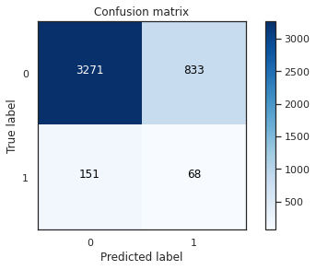
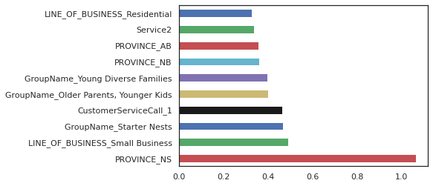
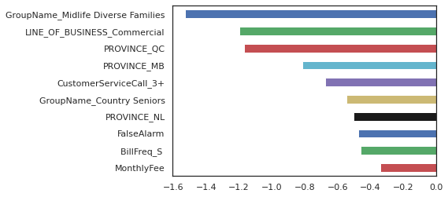
Churn Model Script: GitHub Repo
Legend
Class 0| Not Churn
Class 1| Churn
Model Evaluation
Classification Report
Feature Importance: Top 10 features resulting in Churn
Feature Importance: Top 10 features resulting in Not Churn
The rationale for selecting the model with best recall score
of Class 1: Churn, and acceptable average recall score is to reduce the number of wrong predictions (Type 1 & 2 errors)
Type 1 error: False Positive – Predicted Churn but Actually not Churn – Low importance error (833)
Type 2 error: False Negative – Predicted Not Churn but Actually Churn – High importance error (151)
Focus is to reduce Type 2 error as missing prediction of customers that Churn is costly.
Test Hypothesis: Young adult financially independent customers with unsatisfied customer service have high probability of Churning. – Proven correct

Slide 9
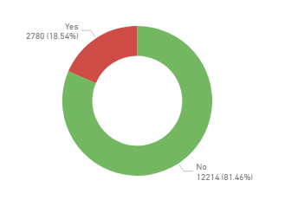
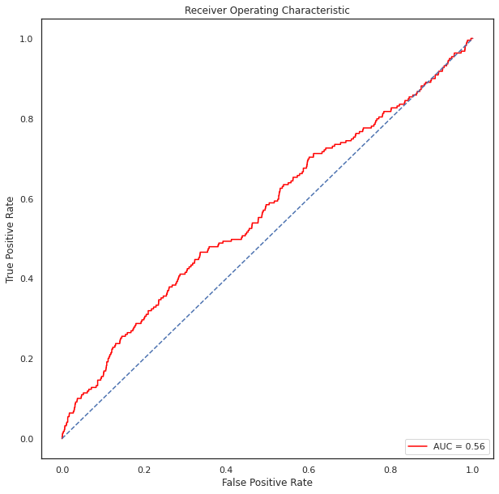
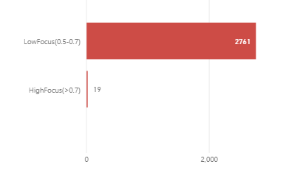
Action Plan & Strategies
Model Prediction: Scoring Dataset
The predicted Churn rate is ~ 18% (Threshold 0.5)
with maximum Customers having lower probability of Churn.
The High Churn Prediction is attributed to the fact of High Type 1 errors: False Positive – Predicted Churn but Actually not Churn (a limitation of modelling with Imbalanced Dataset).
Based on the prediction
19 High Focus Customers with maximum Churn probability require strategic intervention for Churn prevention.
2761 Low Focus Customers which require targeted monitoring for Churn prevention.
However to minimize Type 2 errors (False Negative), threshold of 0.4-0.49 (ROC) could be used which would result in higher LowFocus customers predicted but reduce False Negatives (costly errors) – Business consideration

Slide 10
Action Plan & Strategies
Model Refinement
The model can be improved by the following
Analyzing customer feedback data (social media comments, customer care feedback) as Customer satisfaction is an important variable impacting Churn.
Analyzing Customer tenure data as end of tenure is an important inflection point for Churn.
Analyzing Customer location data as location safety index / crime index, as well as competitor service availability would have an impact on Customer Churn (Assumption: Data for Security System Services).
Customer Retention Strategies
Engage focus customers to determine and improve (if required) current customer satisfaction.
Enhance and improve Social media outreach to promptly address customer feedback.
Improve Customer service process with automation e.g. Chatbots
Develop bundled service packages targeting young independent adults – e.g. bundled internet services, gaming services etc.
Develop loyalty programs to increase the customer service tenure.

Slide 11
THANK YOU

Slide 12
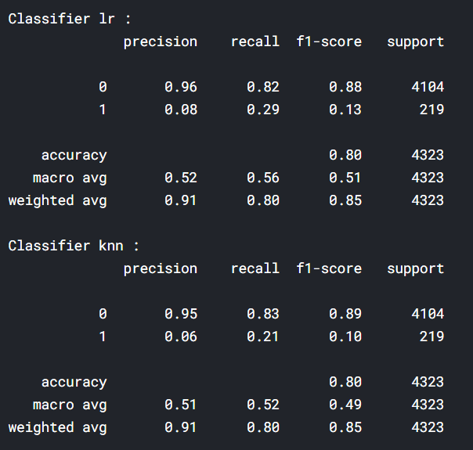
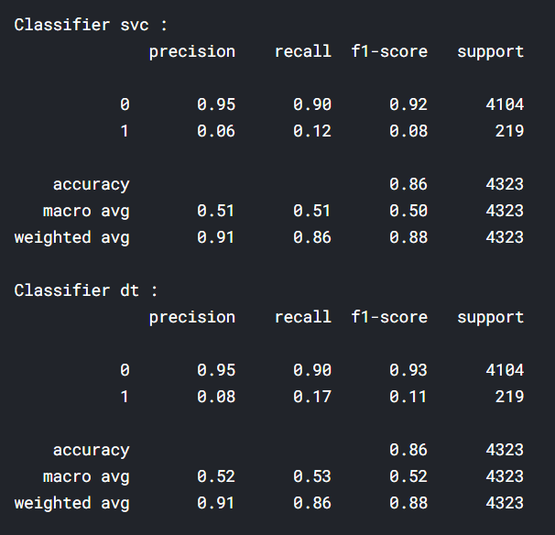
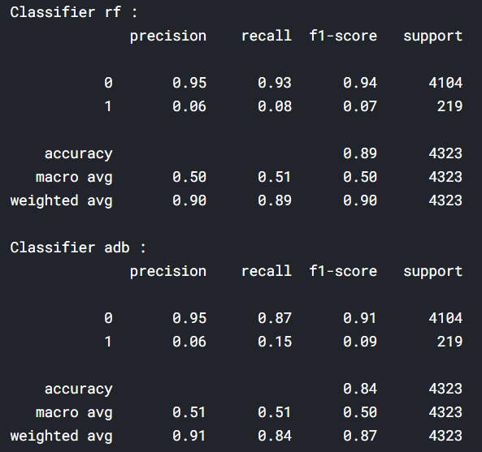
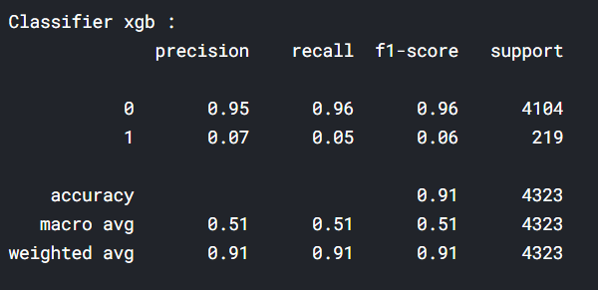
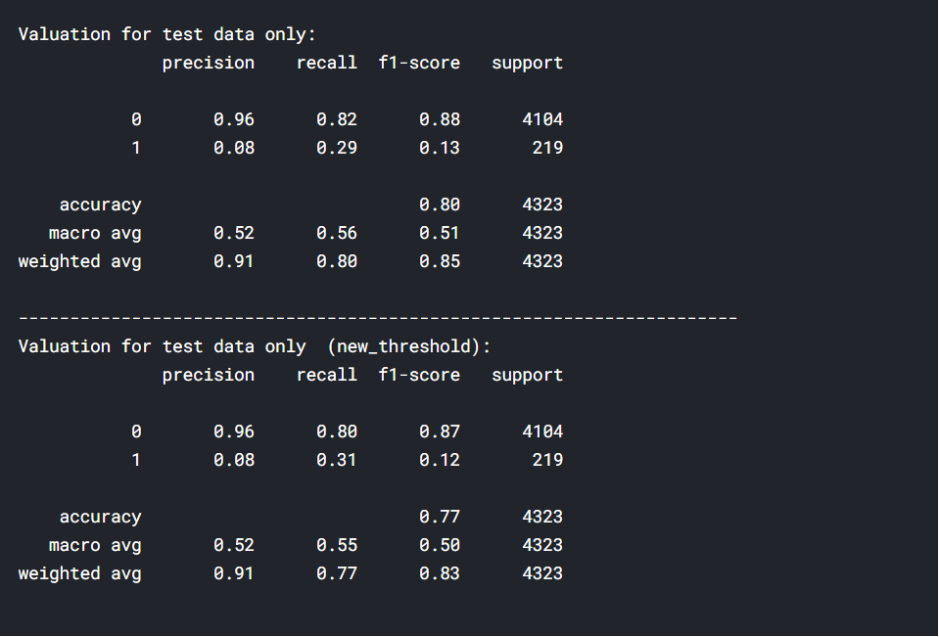
Appendix
Model Performance: All
Model Performance: Threshold
Original: 0.5
New: 0.49
Script: GitHub Repo

